Slide 1
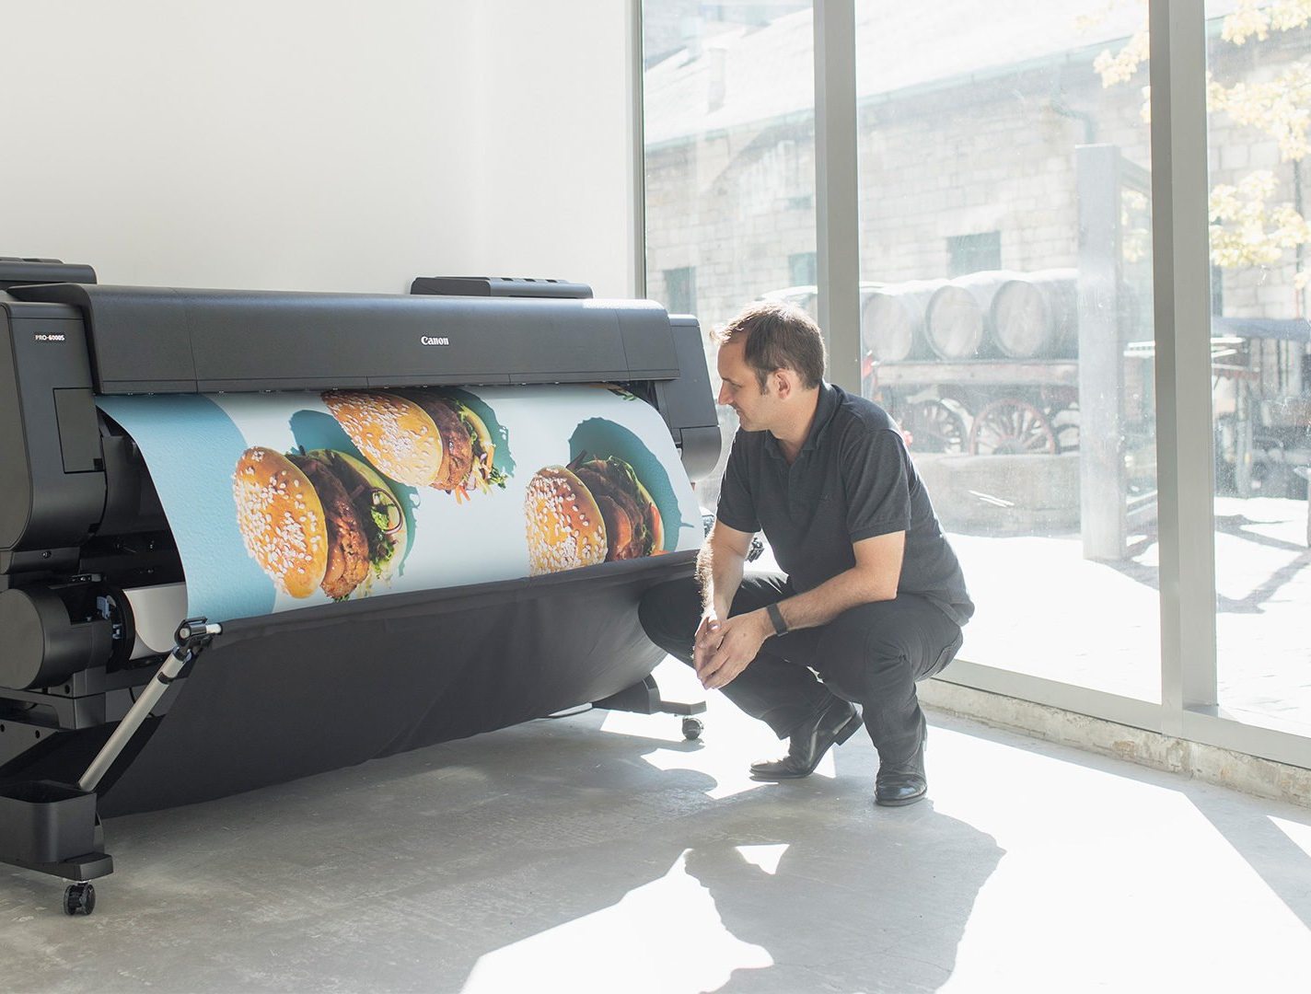
Advanced higher Graphic communication
DTP Printing Technologies

Slide 2
Learning intentions & success criteria
Learning Intentions
Gain an understanding of the different types of printing processes.
Success Criteria
Explain the processes of each type of printer.
State which process is best suited to a particular project.

Slide 3
Printing processes
In the Advanced Higher Graphic Communication course, you need to have an understanding of the following printing processes:
Laser Printing
Ink Jet Printing
Screen Printing
Offset Lithography
Wide Format Printing

Slide 4
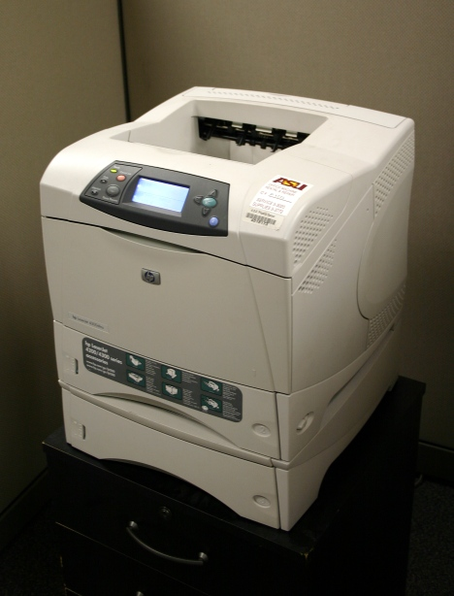
Laser printing
Laser printing is an electrostatic digital printing process.
It produces high-quality text and graphics (and moderate-quality photographs) by repeatedly passing a laser beam back and forth over a negatively-charged cylinder called a "drum" to define a differentially-charged image.
The drum then selectively collects electrically-charged powdered ink (toner), and transfers the image to paper, which is then heated to permanently fuse the text, imagery, or both, to the paper.

Slide 5
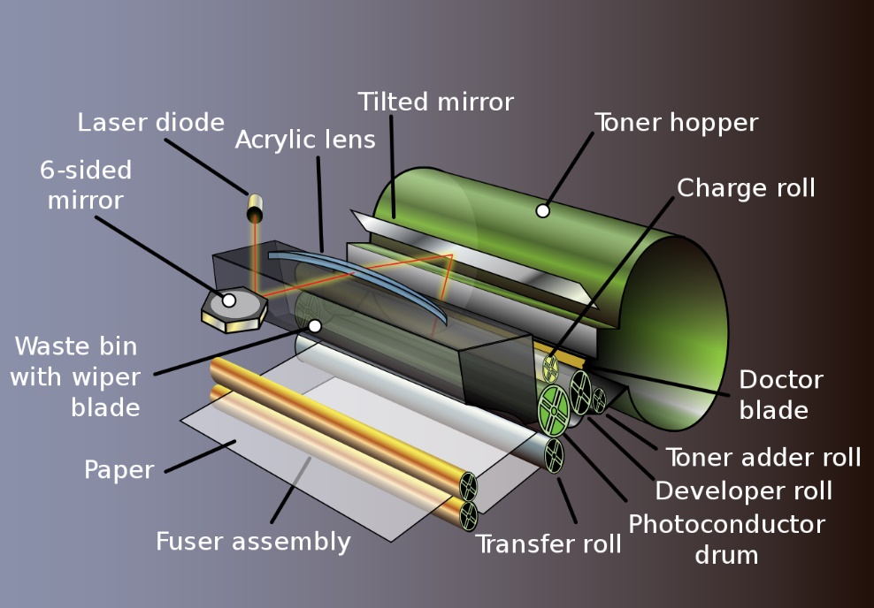
Laser printing
Main features:
The toner or ink in a laser printer is dry. In an inkjet, it is wet.
The ink does not need to be changed as often as it does in an inkjet printer.
The ink on a laser printed document will not smear.

Slide 6
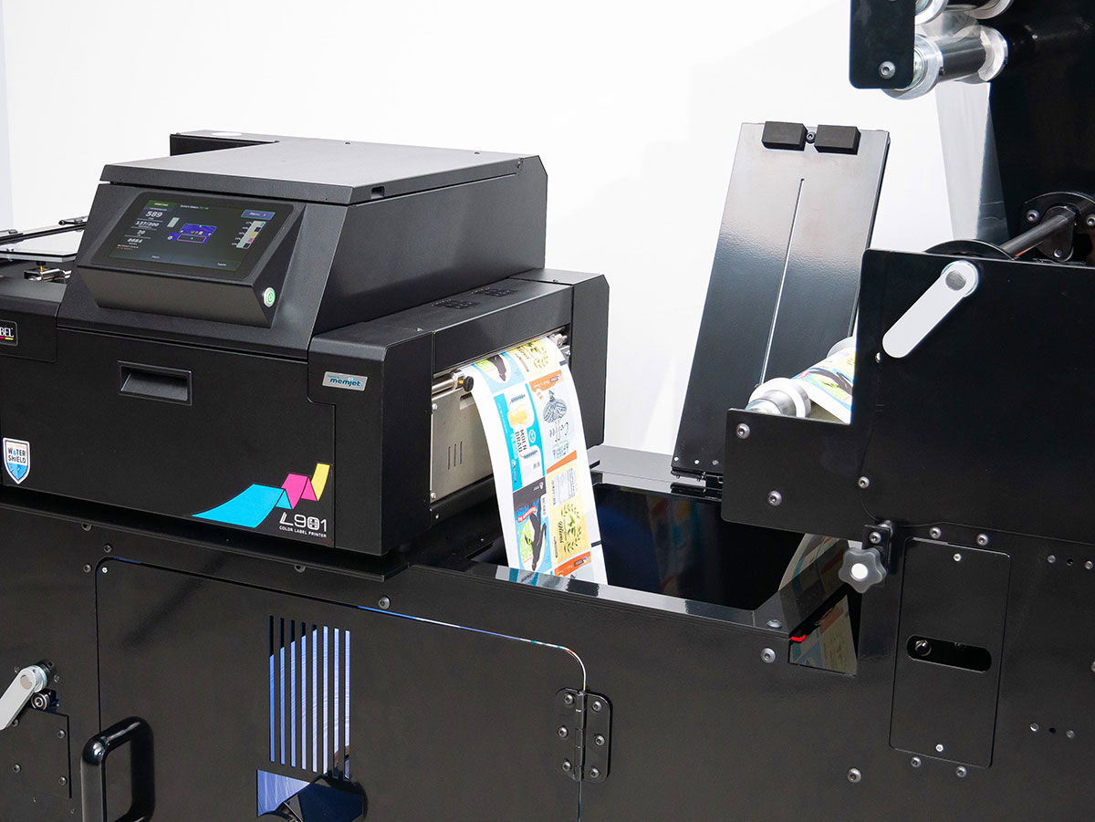
Laser printing
Economy of print run size:
Personal laser printers are sufficient for printing an average of 200 pages per week.
A workgroup printer is needed if an average of 1000 pages per week is needed.
Production printers are needed for printing 50,000 or more pages per week. These are quite expensive and are used by commercial publishers.

Slide 7
Laser printing
Materials to be printed on:
Most laser printers use standard papers sizes (A4/A3).
High-end production printers use continuous sheet paper.
Laser printers can print on transparencies, adhesive labels and light weight cards, showing great flexibility and versatility.

Slide 8
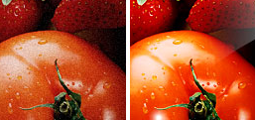
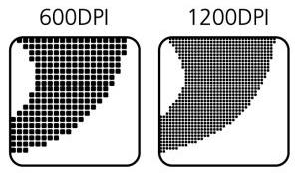
Laser printing
Print quality :
The standard resolution in most laser printers is 600 dots-per-inch (dpi). Sufficient for normal, everyday printing-including small desktop publishing jobs.
A high end production printer might have a resolution of 2400 dpi.
Lower resolutions can cause jagged lines to appear on the outer edge of an image.
Hewlett Packard created RET (Resolution Enhancement Technology) to correct this. RET inserts smaller dots at the edge of lines and to smooth the rough edges. RET does not improve the resolution, the but the document looks better.

Slide 9
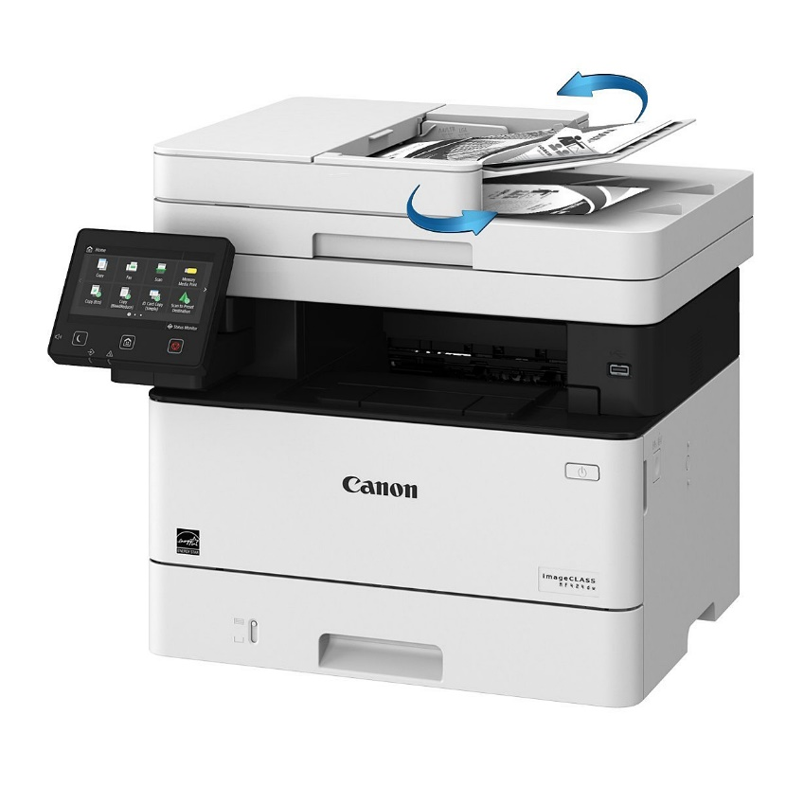
Laser printing
Printing speed:
Personal laser printers can print up to eight ppm (pages per minute).
A workgroup printer can print up to 24 ppm.
Production printers can print up to 700 ppm and can print 24hrs a day, 7 days a week.

Slide 10
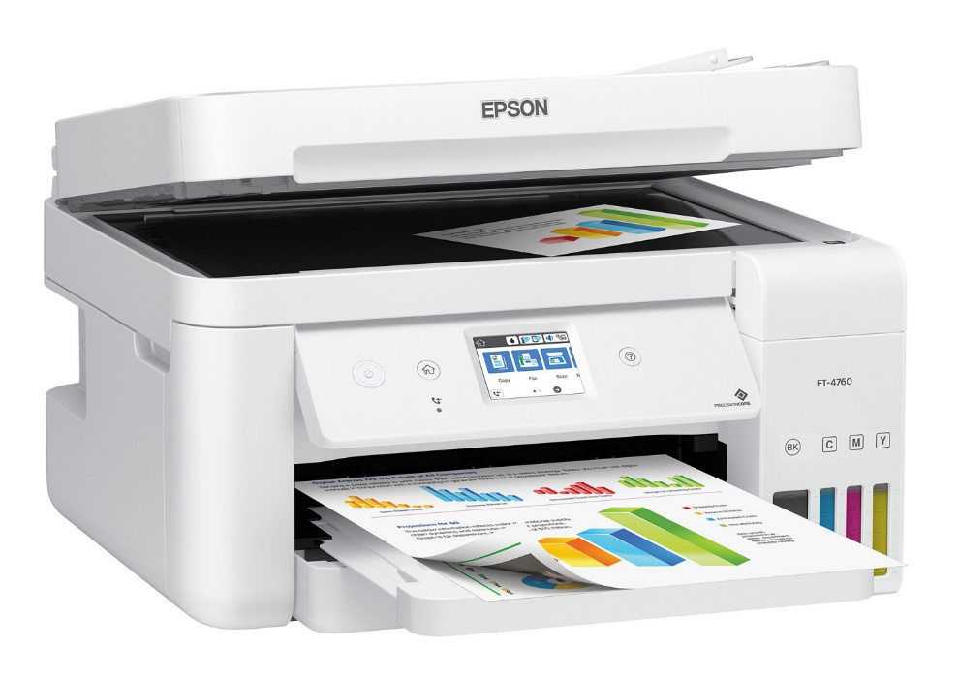
Inkjet printers
Inkjet printing is a type of computer printing that recreates a digital image by propelling droplets of ink onto paper and plastic substrates.
Inkjet printers are the most commonly used type of printer and range from small inexpensive consumer models to expensive professional machines.

Slide 11
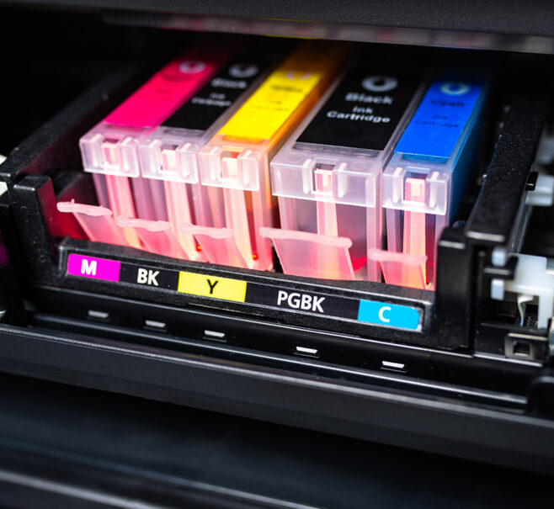
Inkjet printers
Main features:
Inkjet printers are, in the main, inexpensive, lightweight and small. This makes them ideal for a personal computer.
The copy form an inkjet printer needs a little time to dry.
Adequate drying time is especially important if the hard copy contains large regions of solid black or colour.
Economy of print run size:
A limitation is the fact that most inkjet printers are slow and they are not designed for high-volume jobs.

Slide 12
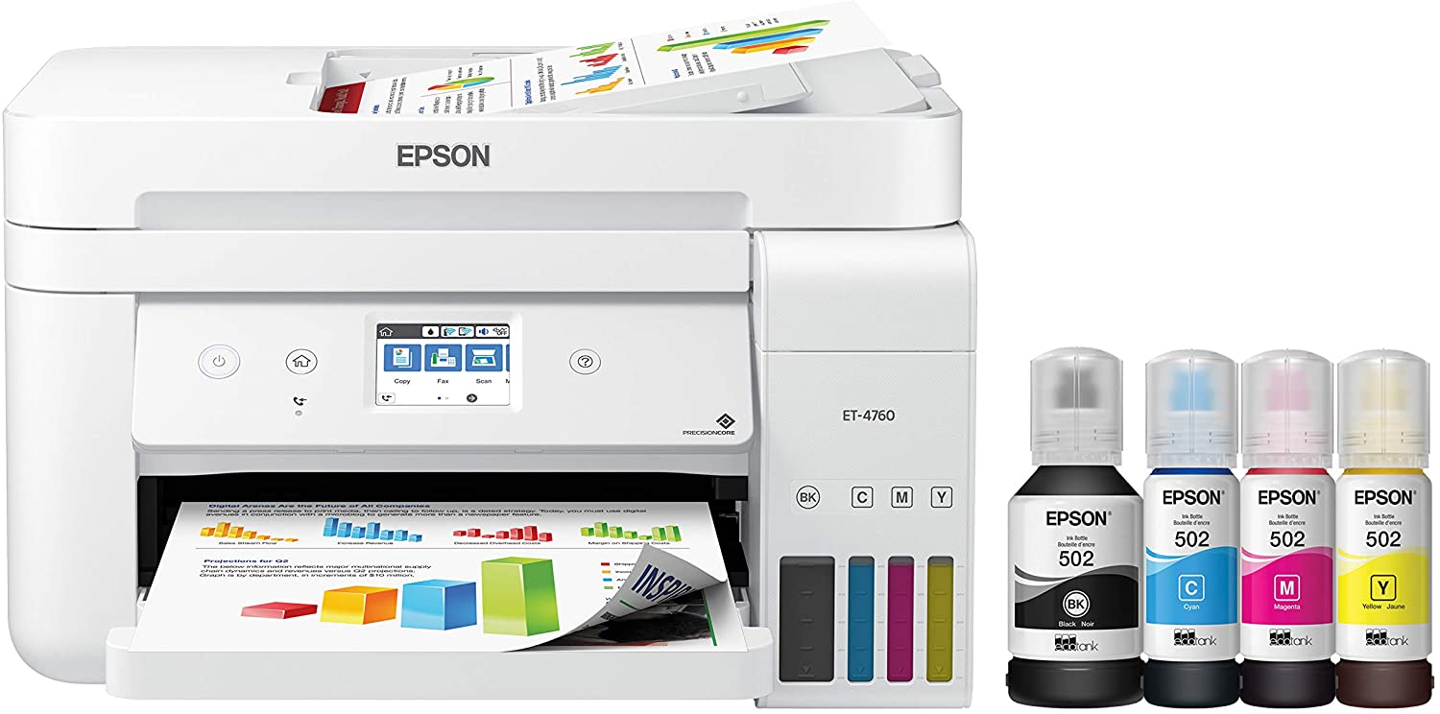
Inkjet printers
Materials to be printed on:
Inkjet printers also require non-porous paper. In bond paper containing cotton or other fibres, the ink may bleed along the fibres.
Paper designed especially for inkjet printers is heavier than the paper used with laser printers, has a higher brilliance and is more expensive.
Print Quality:
A typical inkjet printer can produce a copy with a resolution of at least 300 dpi.
Some inkjet printers can make full colour hard copies at 600 dpi or more.
Printing speed:
Slow

Slide 13
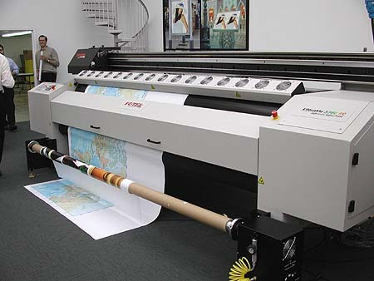
Wide format printing
Main features:
Wide format printers usually employ inkjet print technology to produce the printed image. CMYK colours are also used.
The greatest difference between digital wide format printing and traditional methods such as lithography, flexography or letterpress is that there is no need to replace printing plates in digital printing; in the other methods printing the plates are repeatedly replaced and are expensive to produce.

Slide 14
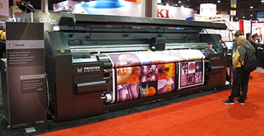
Wide format printing
Economy of print run size:
They are more economical than other print methods such as screen printing for most short-run (low quantity) print projects, depending on print size, run length (quantity of prints per single original) and the type of substrate or print medium.
Print Quality: High Quality
Printing Speed: Slow, but bear in mind print runs will generally be very small or even one-off banners etc.

Slide 15
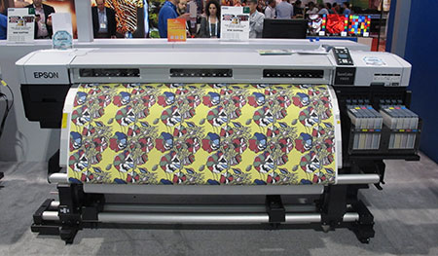
Wide format printing
Materials to be printed on:
The media can be paper based, sheet vinyl, various banner materials, mesh, canvas or any other printable materials available.
Wide format printers are usually designed for printing onto a roll of print media that feeds incrementally during the print process, rather than onto individual sheets.
Wide format printers are used to print banners, posters, trade show graphics, wallpaper, murals, backlit film (aka duratrans), vehicle image wraps, electronic circuit schematics, architectural drawings, construction plans, backdrops for theatrical and media sets an any other large format artwork or signage.

Slide 16
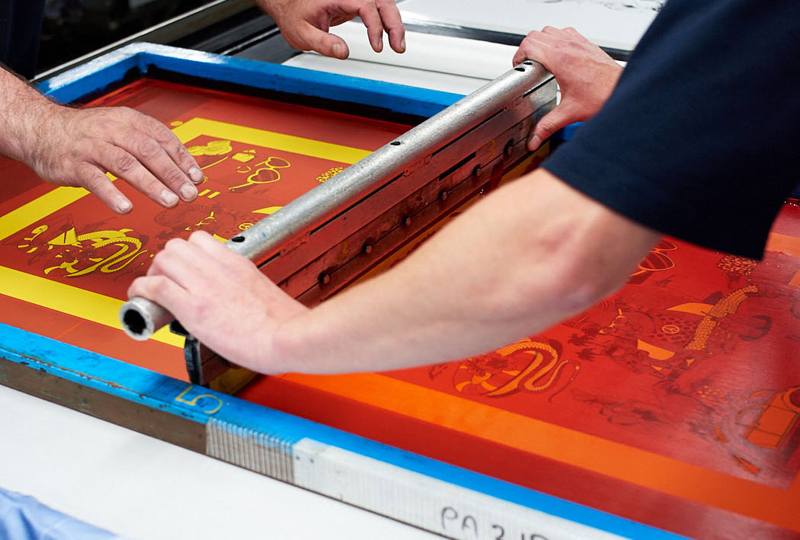
Screen printing
Main features:
At its simplest, Screen printing involves making a stencil which is adhered to a fine nylon mesh screen attached to a frame. Using a squeege, the ink is pushed through the stencil and onto the print surface.
Screen printing is the best option for designs that require a high level of vibrancy, when printing on dark shirts, or for specialist products.
The ink in screen printing is applied thicker than digital printing, which results in brighter colours even on darker shirts.

Slide 17
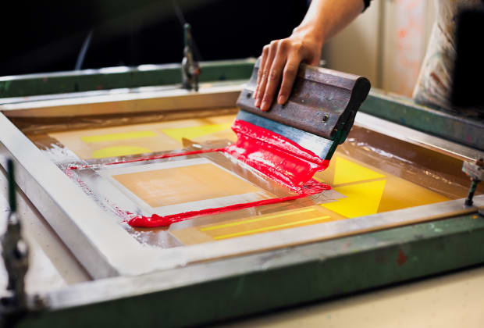
Screen printing
Economy of print run size:
Screen printing has a strong commercial presence as press speeds increase.
Screen printing is also economical over short print runs because it is relatively cheap to set up.
High speed, large format inkjet printing and other advances in print technology have made Screen printing less competitive for certain types of work.
Screen printing also tends to be used for more specialist items, such as printing onto metals, plastics or for one-off items for which digital printing is not viable, due to the shape or thickness of the surface.

Slide 18
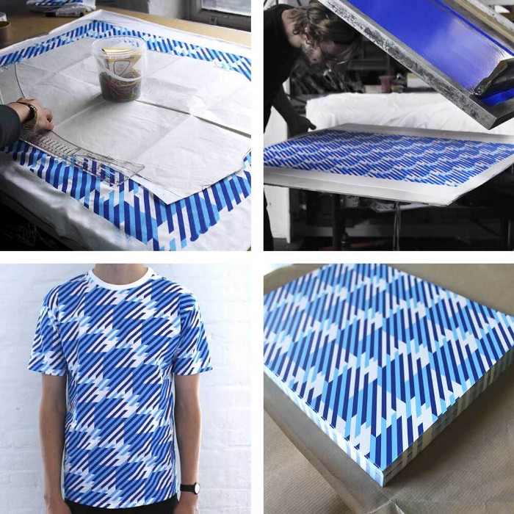
Screen printing
Materials to be printed on:
The advantage of screen printing is its adaptability. One screen can be used again and again.
There are not limits on the amount of colours that may be used and light colours can be overprinted easily onto dark colours.
Screen printing is the best option for designs that require a high level of vibrancy, when printing on dark shirts, or for speciality products.
The ink in screen printing is applied thicker than digital printing, which results in brighter colours even on darker shirts. The print quality can be excellent.
Printing speed:
Modern cylinder-based screen presses are capable of 4,000 to 6,000 impressions per hour and ink-dying systems shorten the drying time of the inks. The modern process can be very economical.

Slide 19
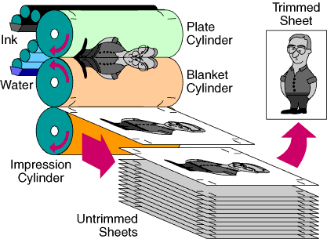
Offset lithography
Main features:
This is the most popular printing technique used for most printed matter we encounter such as leaflets, booklets, magazines and catalogues.
Economy of print run size:
The cost of offset printing is the cheapest method of producing high quality printing in commercial printing (high volume) quantities. It is too expensive to set up to be useful on smaller print runs.

Slide 20
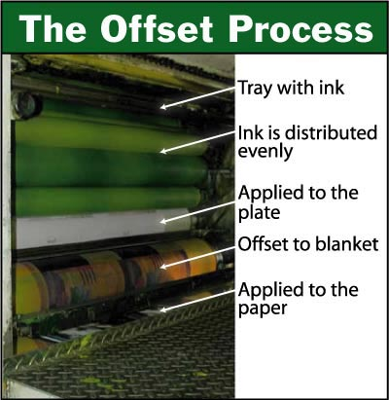
Offset lithography
Materials to be printed on:
Offset lithography is one of the most common ways of creating printed materials.
Common applications include: newspapers, magazines, brochures, stationery and books.
Compared to other printing methods, offset printing is best suited for economically producing large volumes of high quality prints.
Printing Speed:
It is the fastest and most economical method of printing large runs (magazines & newspapers etc.) hence the reason it is widely used.

Slide 21
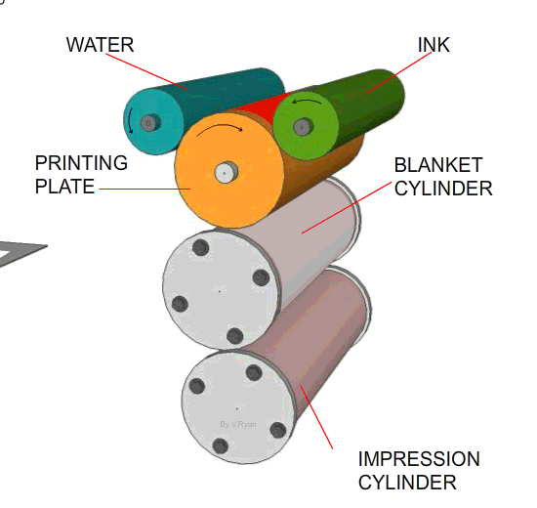
Offset lithography
Print Quality:
For offset printing a lot more attention to detail is required but the quality of the results is excellent. The advantages are:
Allows the widest range of colour re-production. Bright florescence, Pantones, metallic, foils and varnishes can all be produced using this method of printing.
Allows the most accurate colour re-production and consistency.
A wide variety paper weights, size and textures.

Slide 22
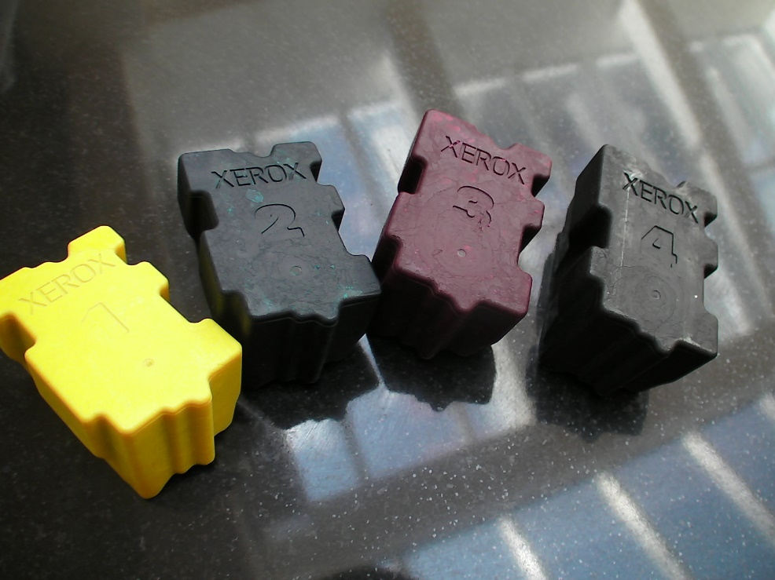
Solid ink systems
Main features:
Solid ink technology utilises solid ink sticks instead of the fluid ink or toner powder.
Some types of solid ink printer use small spheres of solid ink, which are stored in a hopper before being transferred to the printing head.
After the solid ink is loaded into the printing device, it is melted and used to produce images on paper in a process similar to offset lithography printing.
Xerox claims that solid ink printing produces more vibrant colours than other methods is easier to use, can print on a wide range of media, and is more environmentally friendly due to reduced waste output.
The sticks are non-toxic and safe to handle.

Slide 23
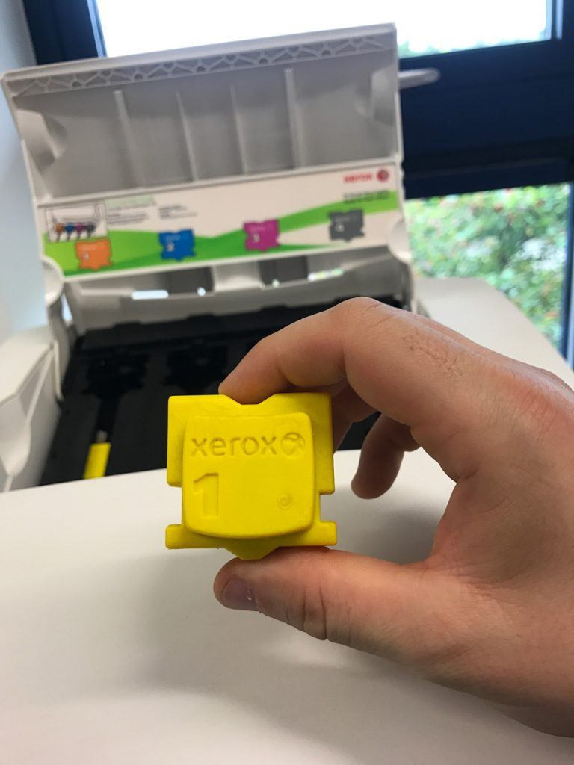
Solid ink systems
Economy of print run size:
Solid ink printing has several advantages that make it attractive for business, including:
Good print quality at speeds up to 40 pages per minute
Less packaging waste compared to inkjet and laser models
The technology also has a few downsides, such as the time needed to heat the ink.
Materials to be printed on:
Mainly paper where it maintains its quality on a range of paper types.

Slide 24
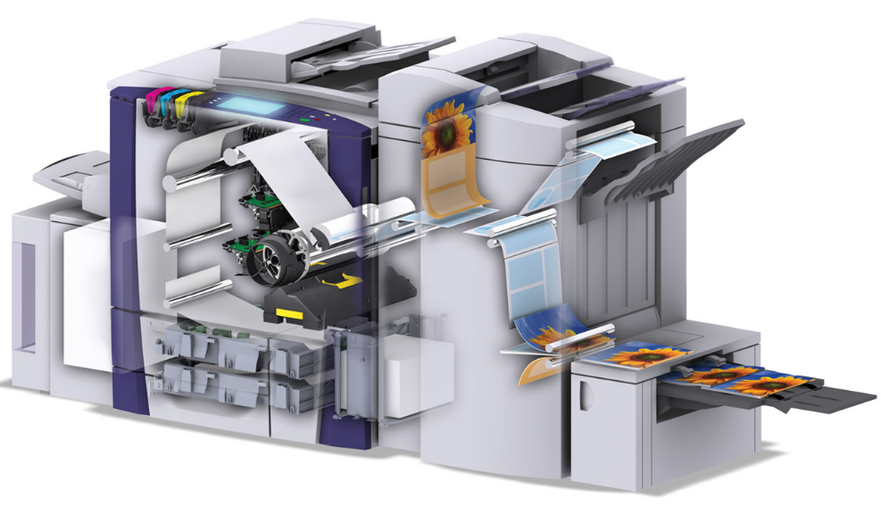
Solid ink systems
Print Quality:
When evaluating print quality, you should examine print samples across a variety of prints on a variety of media.
Solid ink pixels are much more discrete and can be precisely placed to within ½ of a pixel.
Although solid ink pixels (spots) are not smaller than toner particles they can be placed as a singe pixel, unlike toner particles that are placed on the image in “clumps” to create a singe pixel.
Colour-to-colour output is more consistent with solid ink than with laser toner.

Slide 25
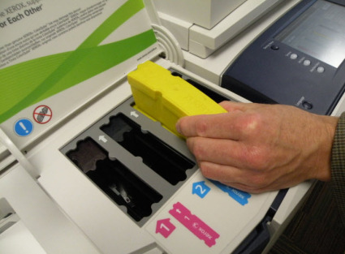
Solid ink systems
Print Quality:
Due to the way solid ink printers put the ink onto the page, print quality is considered to be excellent with bright colours.
Excellent results can be achieved with low-quality stock as the wax covers the stock with a glossy, almost opaque, surface.
Solid ink printers are able to print on many different types and thicknesses of media.
Because solid blocks of ink are used, there is less waste generated than is with laser printers or inkjet printers, which produce empty ink or toner cartridges, in addition to packaging and packing materials.
A loose ink block does not leave any residual cartridge after it is consumed – only a crushable, thin, plastic packing tray and a recyclable cardboard packaging box.

Slide 26
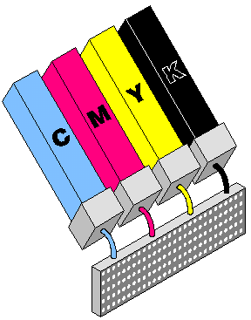
Solid ink systems
Print Quality:
Solid ink printers have an advantage over ink-jet printers for situations involving intermittent use with long periods of downtime. This is because melted solid ink that has subsequently cooled and re-solidified inside the ink-delivery pathways is a normal part of printer operation. So this cooled-and-solidified ink does not dry out.
While the printer is not operating, the solidified wax helps to prevent oxygen and moisture from interacting with many internal parts of the ink-delivery components.
Printing Speed:
The average solid ink printer can print up to 40 pages per minute. Not as quick as offset lithography printing.

